Slide 1
Flight
Continuity Equation
and the
Bernoulli Principle
LabRat Scientific
© 2019

Slide 2
The lift generated by an airplane wing is the result of a pressure imbalance between the top and bottom surfaces of the wing.
Low Pressure
High Pressure
The question is – How is this pressure differential created?

Slide 3
Theoretical Ground Rules
This lesson requires that we assume some basic characteristics for the airflow:
Subsonic – the velocity of the fluid/gas is less than the speed of sound
Steady – When a fluid particle passes a specific point on a streamline its velocity and direction will be the same as the particle that previously passed that same point
Incompressible – the density of the fluid/gas does not change as it moves through the system
Nonviscous – the fluid/gas particles slip past one another with no friction
Irrotational – the flow is not swirling or turbulent

Slide 4
To understand how lift is generated we need to examine two things:
What is happening to the airflow around the airfoil or wing?
How is the airflow affecting the pressure distribution around the airfoil or wing?

Slide 5
Conservation of Mass
And
the Continuity Equation

Slide 6
Fluid Moving Through a Tube
We can gain an understanding of how the air moves over an airfoil by examining how air (also known as a “fluid”) moves through an open-ended tube.
If we apply a pressure on the left-hand side of the tube that is higher than the pressure on the right-hand side, the fluid will move towards the right.

Slide 7
Fluid Moving Through a Tube
The air doesn’t move as a blob as depicted in the previous slide, it moves in a relatively organized manner where the gas molecules follow paths known as “streamlines”

Slide 8
Streamlines
This is a streamline
X
v
In a “steady” flow, streamlines can not cross one another. However they they can influence one another – act as a tube wall for example…
All of the gas molecules in the flow will follow one streamline or another.
The gas molecules will have the same speed and direction as they pass specific points on the streamline.

Slide 9
Conservation of Energy:
In a steady flow, the sum of all forms of energy in the fluid along a streamline is the same at all points on that streamline.
Generally speaking, the energies involved with a low speed fluid flow are Potential Energy (PE) and Kinetic Energy (KE).
From a mathematical perspective: PE + KE = Constant

Slide 10
Fluid Moving Through a Tube
It can be difficult to look at all the molecules in the flow at the same time, so we will just look at a bundle of them as they move through the tube.

Slide 11
Fluid Moving Through a Tube
The tube is a 3-dimensional object, so the particles actually represent a specific “volume”.
The mass of the molecules contained within the volume is a function of the volume and the density of the fluid:
Mass (kg) = Density (kg/m³) x Volume (m³)

Slide 12
Mass Flow Rate
Experiments involving a fluid moving through a tube of changing cross-sectional area show that the mass of the fluid moving past any given point in the tube every second remains constant.
“Mass” moving past a point over “time” is known as the Mass Flow Rate.
Mass Flow Rate (kg/sec) = Mass (kg) / Time (sec)
If the Mass Flow Rate (and thus the “volume”) remains constant, the shape of the molecule volume must change as the cross-sectional area of the tube changes.

Slide 13
Mass Flow Rate
As the cross-sectional area of the tube decreases the flow is forced to be squished in the vertical direction. The reduction in the vertical dimension requires the “length” of the molecule volume to stretch out in order to maintain a constant volume.

Slide 14
Mass Flow Rate
Velocity
Velocity
If the amount of mass passing any given point every second remains constant, the molecules in the stretched out volume must move faster in order to get the same amount of mass across the point in the same amount of time.

Slide 15
Conservation of Mass
The Mass Flow Rate (also known as the Mass Flux) can also be expressed using the following equation:
Mass Flux = Density x Area x Velocity
Looking at the units:
kg/sec = kg/m³ x m² x m/sec
If we look at the Area multiplied by Velocity, we see that it represents a Volume divided by Time, which represents a Volumetric Flow Rate:
Area x Velocity = m² x m/sec = m³/sec

Slide 16
The Continuity Equation
Since the Mass Flux is constant, we can set up the following relationship for any two points along the tube:
Density₁ x Area₁ x Velocity₁
= Density₂ x Area₂ x Velocity₂
For an incompressible fluid, the density remains constant and thus can be dropped from the equation.
The equation can then be simplified as follows:
Area₁ x Velocity₁ = Area₂ x Velocity₂
This is known as the Continuity Equation for a flow…

Slide 17
The Continuity Equation
The Continuity Equation states that as the area through which a fluid flows changes, the velocity of the flow changes accordingly such that the mass flow rate (and also the volumetric flow rate) remains constant.
For example, cut the area of the tube in half, and the velocity of the flow will double.

Slide 18
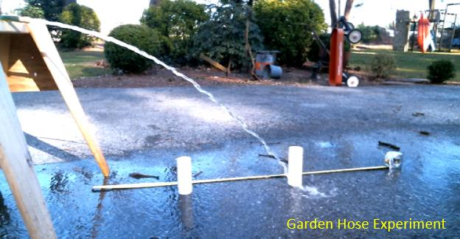
A garden hose can be used to demonstrate Conservation of Mass in association with a moving fluid. Two different exit areas will be tested at the same water supply pressure.

Slide 19
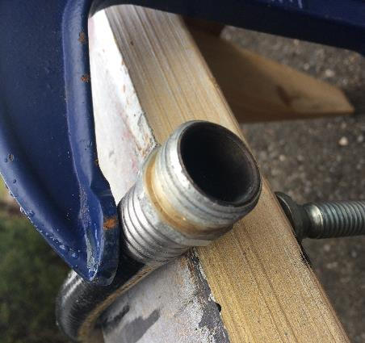
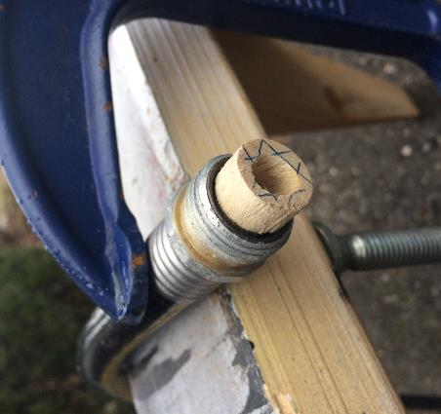
Area₁
Area₂
Velocity₂
Velocity₁
The experiment looks at the two flows separately, but the two openings can be thought of as two cross-sectional areas of a tube. The velocities of the resulting flows represent the flow velocities in the two different sections of the tube.

Slide 20
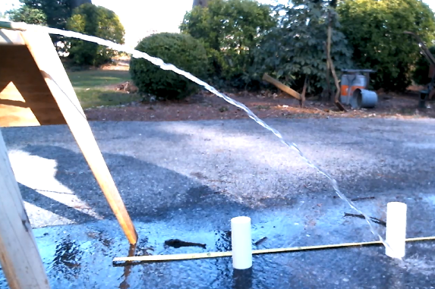
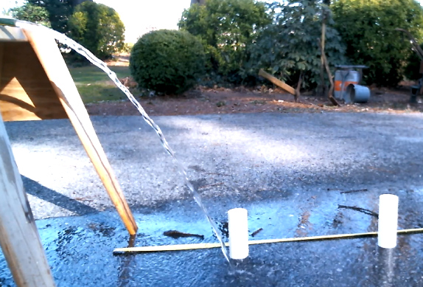
Experimental Results
The smaller opening caused the water stream to travel twice as far as the larger opening.
0.5 m
1.0 m

Slide 21
Calculating Flow Velocity
The average velocity of the water stream can be calculated by dividing the horizontal distance it travels by the time it takes to travel that distance.
0.5 m
While the vertical velocity changes due to gravity, the horizontal velocity is essentially constant.
1.0 m
The “time” factor is the time it takes the water to free fall to the ground – it is a mass falling under gravitational acceleration...

Slide 22
Calculating Flow Velocity
Time is takes water to fall 0.74 m:
Distance = ½ x Accel x Time²
2 x Distance
Time = -----------------
Acceleration
Freefall Distance
0.74 m
2 x 0.74 m
Time = ----------------
9.8 m/sec²
Time = 0.39 sec

Slide 23
Calculating Flow Velocity
Velocity_{Ave} = Distance / Time
= 0.5 m / 0.39 sec
= 1.28 m/sec
Opening Size | Water Stream Velocity
Large Opening (1.5 cm dia) | 1.28 m/sec
Small Opening (1.0 cm dia) | 2.56 m/sec
From the experiment, we see that cutting the exit area in half will double the velocity of the water stream. Is this what the Continuity Equation predicts?

Slide 24
Applying the Continuity Equation
Small Opening:
Diameter = 1.05 cm = 0.0105 m
Area = 3.1416 x (0.00525 m)²
Area = 0.000087 m²
The large opening has approximately twice the area of the small opening.
0.5 m
1.0 m
Large Opening:
Diameter = 1.5 cm = 0.015 m
Area = 3.1416 x (0.0075 m)²
Area = 0.000177 m²

Slide 25
Applying the Continuity Equation
Area₁ x Velocity₁ = Area₂ x Velocity₂
0.000177 m² x 1.28 m/sec = 0.000087 m² x Velocity₂
0.000177 m² x 1.28 m/sec
------------------------------------- = Velocity₂
0.000087 m²
2.6 m/sec = Velocity₂

Slide 26
Experimental vs. Theoretical
 | Velocity2
Experimental | 2.56 m/sec
Theoretical | 2.60 m/sec
While the experimental and theoretical values are not exactly the same, they are certainly within measurement and round-off errors.
It is safe to say that the simple hose experiment confirms the concept of Conservation of Mass in association with fluid flows.

Slide 27
Now that we know a fluid’s velocity will increase as the area through which it is moving decreases, the next step is to examine how the pressure of the flow is affected.
To do this, we need to examine the Bernoulli Principle…

Slide 28
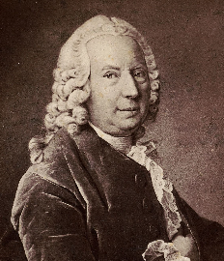
Bernoulli’s Principle states:
“The static pressure of a fluid (gas) decreases as the velocity of the fluid
increases.”
Bernoulli (1700 – 1782) experimented with liquids flowing through pipes and he created the concept of “hydrodynamics”. His experiments were not related to flight, but air is a fluid, and so the principle applies…

Slide 29
Before we begin, we need to understand the distinction between the pressure and density of a fluid/gas in a close vessel (static) and an open-ended tube (dynamic).
Enclosed Container
Pipe
In aerodynamics, when a flow is subsonic (below the speed of sound) the air can be considered to be “incompressible” – meaning its density doesn’t change. Confusion can emerge due to the fact that we know there are “air compressors” which are used to fill things like SCUBA tanks and car tires. If we used air compressors on a daily basis, how can we say air in incompressible?

Slide 30
Static Pressure
First, let’s look at the case of a sealed container. In this situation the fluid/gas is considered to be static – which means the fluid is not moving of flowing…
A simple experiment can be conducted to prove that air can be compressed.

Slide 31
Pressure and Density in a Closed Container
Air Pump
Low Pressure
High Pressure
Density = 12 Units / Container
Density = 36 Units / Container
More gas molecules are pumped into the container on the right so the pressure is higher. Also, more molecules = more mass and more mass per volume = higher density.

Slide 32
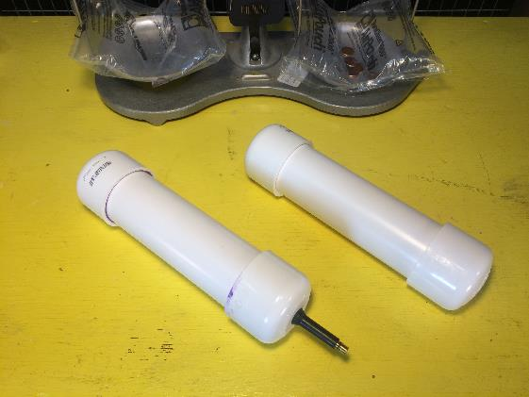
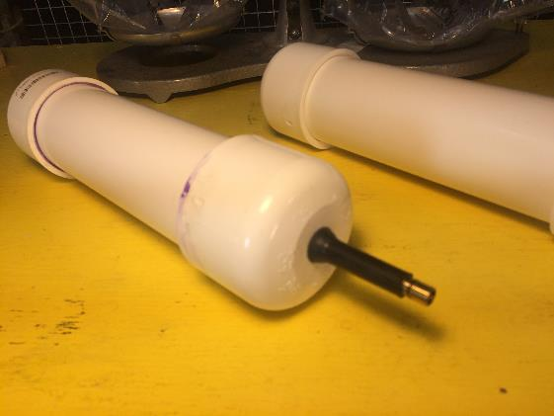
Experimental Verification
Two nearly identical containers. The only difference is that one was outfitted with a Shrader Valve to allow pressurized air to be added.
A compressor was used to pump air into one of the sealed containers to a pressure of 20 PSI.
Warning: Pressurized containers can contain significant potential energy that can cause harm if rupture occurs. Do not handle pressurized containers without proper training.

Slide 33
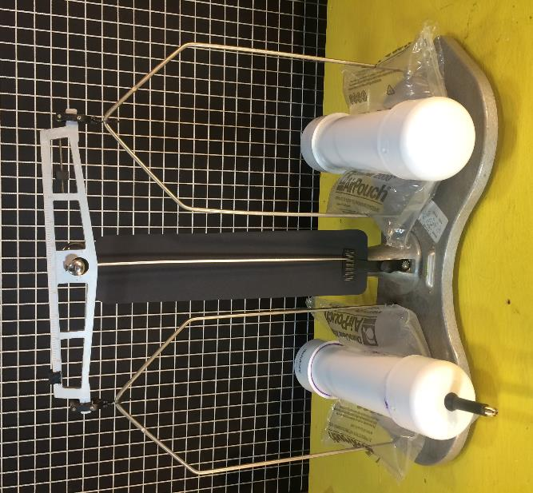
Experimental Results
Using a sensitive balance, it was determined that the pressurized container had approximately 0.7 grams more air than the unpressurized container.
Since the containers hold the same volume of air, the pressurized container has a higher density since there was more air mass contained in the volume.

Slide 34
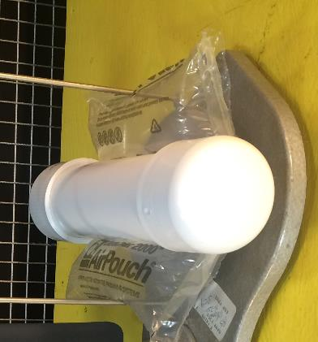
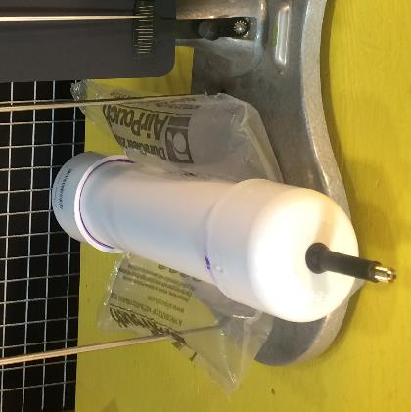
Experimental Results
Unpressurized Container:
Volume = 0.24 m x (3.1416 x (0.025 m)²) = 0.0005 m3
Air Mass = 0.0005 m₃ x 1.225 kg/m³ = 0.0006 kg
Pressurized Container:
Pressurized with 20 PSI of air
Volume = Same as ambient container
Air Mass = Ambient Mass + 0.0007 kg = 0.0013 kg

Slide 35
From this simple experiment we can see that the density of the air in the pressurized container was essentially twice that of the of the air in the ambient container.
This confirms that air is actually compressible. As such, its understandable that there is some confusion when we state that air flowing through a tube or over an airfoil is incompressible.
The thing to remember is that flow through a tube is not the same thing as gas contained in a pressure vessel. When flow is moving through an open-ended tube, the pressure and fluid velocity can adjust such that the fluid density remains constant.

Slide 36
In the case of an enclosed container, we have a “static” situation where the air is not moving in any particular direction – the molecules are just randomly bouncing around. The air pressure within the container is known as “static pressure”
When we consider air flowing through an open-ended tube it is a “dynamic” situation. When a dynamic situation exists and the air is moving there are two types of pressure - static and dynamic…

Slide 37
Flow in an open-ended tube:
The Mass Flow Rate (amount of pass moving by a point every second) is constant.
Mass Flow Rate is the same thing as Volumetric Flow Rate (volume of fluid moving past a point every second) with respect to flow moving through a tube .
The pressure, velocity, or density of the flow must change in order to accommodate the mass continuity of the flow.
For subsonic flow, any compression of the air (density change) is negligible. The flow is said to be incompressible.
Since density essentially remains constant, velocity and pressure are the only variable quantities governing the flow characteristics in the tube.

Slide 38
Fluid (gas) Flow in a Tube
Open to the atmosphere = low pressure…
Pressure
While the individual fluid particles are moving in all directions (this is what causes the pressure on the walls), the overall fluid mass is moving towards the right.
The pressure being applied to the fluid from the left is the Force that causes the fluid particles to move towards the right (F=ma).

Slide 39
Fluid (gas) Flow in a Tube
Pressure
Closed
If the right-hand side of the tube is blocked off, the pressure at the right-hand side of the system would be the same as the left-hand side.
This would cause the Net Force acting on the fluid particles to be zero. If there is no net force acting on the particles they will just bounce around randomly and exhibit no net movement in one direction or another.

Slide 40
Fluid (gas) Flow in a Tube
Open to the atmosphere = low pressure…
Pressure
For the open ended tube, as more pressure is applied at the tube inlet, the fluid particles will move faster due to Newton’s Law (a = F/m).
In the case of an open ended tube, the density does not increase even though the pressure being applied is greater.
This is different from the enclosed container…

Slide 41
Bernoulli’s Equation
v₂
p₂A₂
v₁
Bernoulli’s Equation can be derived by applying the Work-Energy Theorem to a fluid moving though a tube of varying cross sectional area and height (as depicted at the right).
p₁A₁
h₂
h₁
x₂
x₁
p₂A₂
h₂ – h₁
p₁A₁
v₂
h₂
v₁
h₁

Slide 42
Bernoulli’s Equation
v₂
A Pressure Force (p₁A₁) is applied to the left hand side of the tube.
p₂A₂
v₁
The Pressure Force pushes on the fluid and it moves a defined distance x₁.
p₁A₁
h₂
h₁
x₂
x₁
When this happens the Pressure Force performs work (work = force x distance) on the fluid. Since the fluid moves in the direction of the p₁A₁ force the work is positive.
NOTE: Pressure Force p₁A₁ is defined as being greater than Pressure Force p₂A₂. This causes the fluid to move towards the right.

Slide 43
Bernoulli’s Equation
The fluid moves through the tube causing another fluid slug at the right-hand end of the tube to also move towards the right..
v₂
p₂A₂
v₁
h₂ – h₁
The fluid moves to the right because p₁A₁ > p₂A₂.
p₁A₁
h₂
Continuity says both slugs have the same volume. Since the diameter of the right-hand side of the tube is larger, the width of the slug is smaller.
h₁
x₂
x₁
The fluid slug is pushed on by the pressure p₂A₂ from the right. The slug moves distance x₂ towards the right. This distance is shorter due to the larger tube diameter. Since p₂A₂ is pushing opposite the direction of motion, it performs negative work.

Slide 44
Bernoulli’s Equation
The right-hand side of the tube is at a higher elevation than the left. This means the fluid must be lifted. In the diagram, the distance is (h₂-h₁).
p₂A₂
h₂ – h₁
Once again, work is done to lift the fluid. Since gravity is acting against the motion of the fluid, this gravitational work is negative.
p₁A₁
v₂
h₂
v₁
h₁
The total work performed on the fluid is as follows:
Work_{System} = (Press Force x Dist)_{Left} - (Press Force x Dist)_{Right} - Work_{Lifting Fluid}

Slide 45
Bernoulli’s Equation
Work_{System} = (Press Force x Dist)_{Left} - (Press Force x Dist)_{Right} - Work_{Lifting Fluid}
Work_{System} = p₁A₁x₁ - p₂A₂x₂ - mg (h₂ - h₁)
This equation can be simplified if we assume the tube is horizontal and no gravitational work is performed.
v₂
v₁
p₁A₁
p₂A₂

Slide 46
v₂
v₁
p₁A₁
p₂A₂
The simplified equation becomes:
Work_{System} = p₁A₁x₁ - p₂A₂x₂
From the Continuity Equation we know:
A₁x₁ = A₂x₂

Slide 47
From geometry we know that the volume of a right cylinder is the area of the base times the height:
x
A₁x₁ = Volume
Area
From chemistry we know that the volume is also mass divided by density:
Volume = Mass / Density = m / ρ
This means we can substitute “A₁x₁“ with “m / ρ” in the work equation.

Slide 48
Work_{System} = p₁A₁x₁ - p₂A₂x₂
Work_{System} = p₁ (m / ρ) - p₂ (m / ρ)
The two fluid elements have the same mass and the fluid is incompressible so “m” and “ρ“ are constant values (and thus aren’t given a subscript).
From the Work-Energy Theorem, we know that the Work done on an object is equal to the change in Kinetic Energy:
Work_{System} = p₁ (m / ρ) - p₂ (m / ρ) = ½ mv₂² - ½ mv₁²
m
( p₁ - p₂ ) ( -----) = ½ mv₂² - ½ mv₁²
ρ
Performing a little bit of algebra…

Slide 49
m
( p₁ - p₂ ) ( -----) = ½ mv₂² - ½ mv₁²
ρ
Divide each side by “m” and multiply each side by “ρ“.
( p₁ - p₂ ) = ½ ρ v₂² - ½ ρ v₁²
p₁ + ½ ρ v₁² = p₂ + ½ ρ v₂²
Rearranging to group like subscripts.
p + ½ ρ v² = Constant
Bernoulli’s Equation

Slide 50
p + ½ ρ v² = Constant
p is known as the Static Pressure
½ ρ v² is known as the Dynamic Pressure
p + ½ ρ v² is known as the Total Pressure
Bernoulli’s Principle says the Total Pressure in the system must remain constant, so this means the static pressure must drop when the dynamic pressure (a.k.a. flow velocity) increases.

Slide 51
Fluid Moving Through a Tube
Static Pressure
Static Pressure LOWER
Static Pressure
Dynamic Pressure
Dynamic Pressure HIGHER
Dynamic Pressure
Since the flow is incompressible, the Total Pressure along the tube must remain constant. As such, as the dynamic pressure increases the static pressure must decrease.

Slide 52
Static Pressure Profile
P₁
P₂
P₃
P₄
Flow
Pressure (P₄) at end of tube needs to be lower than the pressure (P₁) on the left side in order for fluid movement to occur.
Static Pressure
Flow Accelerates
(a = F/m = Positive)
Flow Decelerates
(a = F/m = Negative)

Slide 53
Dynamic Pressure
Dynamic Pressure = ½ ρ v²
Dynamic Pressure represents the Kinetic Energy of a fluid flow
If the flow has no velocity, there is no Dynamic Pressure
While Static Pressure acts in all directions, Dynamic Pressure acts in the direction of the flow
Dynamic Pressure isn’t really sensed, unless you try to block the flow – or cause it to stagnate

Slide 54
Dynamic Pressure
Dynamic Pressure
Static Pressure
If we look at the wall of the tube we see that the velocity of the flow normal to the surface is zero. Zero velocity means there is no Dynamic Pressure.
V > 0
V = 0
The surface of an airfoil is like the wall of the tube. If the Dynamic Pressure were pushing on the surface along with the static pressure (in other words the “total pressure”) lift could not exist because a pressure imbalance could not occur.

Slide 55
Dynamic Pressure
Total Pressure
Static Pressure
Ambient Pressure
Under these circumstances, the pressure on the top and bottom of the airfoil would be equal and no lift would be generated.

Slide 56
Dynamic Pressure
Total Pressure
Static Pressure
Ambient Pressure
Even if the Dynamic Pressure increased, the Total Pressure would remain constant because the Static Pressure would drop. Still no lift…

Slide 57
Total Pressure
Ambient Pressure
With no flow over the airfoil, the pressure forces are equal and opposite, which means no lift is generated

Slide 58
Dynamic Pressure
Total Pressure
Static Pressure
Ambient Pressure
If Dynamic Pressure only “acts” long the direction of flow, we can see that a pressure imbalance will exist and lift can be generated.

Slide 59
Dynamic Pressure
Total Pressure
Static Pressure
Ambient Pressure
As the flow velocity increases, so does the Dynamic Pressure. Increasing Dynamic Pressure causes a lower static pressure which results in more lift being developed.

Slide 60
So lift is generated by differences in fluid velocity, which causes a pressure imbalance…
Why does the flow over the top of the airfoil move faster than the flow below the airfoil?

Slide 61
Equal-Time Hypothesis
A common explanation as to why the flow over the top of the wing is faster involves the assumption that the gas particles separate at the front of the airfoil at the same time and meet back up at the trailing edge. The particle on the top surface must travel faster over the longer distance in order to meet up with the bottom particle.
Wind tunnel tests show that this is not the case. The flow on top of the wing reaches the training edge first…

Slide 62
Smoke Tunnel Demonstration
Images from University a wind tunnel demonstration
This smoke demonstration shows that the particles in the airflow do not meet up once again at the trailing edge. This is counter to the Equal-Time explanation for the faster moving particles on top of the airfoil.

Slide 63
Two questions come to mind:
Why does the flow follow the contour of the airfoil?
Why does the flow move faster over the top surface?

Slide 64
Why does the air follow the contour of the airfoil?
A particle will tend to move along a straight path if it is not subjected to external forces.

Slide 65
Why does the air follow the contour of the airfoil?
For the particle to move downward towards the surface of the airfoil, Newton says an imbalanced force must be applied to it.

Slide 66
Why does the air follow the contour of the airfoil?
For the particle to move downward towards the surface of the airfoil, Newton says an imbalanced force must be applied to it.

Slide 67
Why does the air follow the contour of the airfoil?
The only forces that might exist are frictional forces and pressure forces.
Frictional forces would make the particle move in the horizontal direction.
So some sort of pressure imbalance must exist to move the particle down.
As the particle moves horizontally and thus away from the airfoil surface, it leaves a void. This void creates a vacuum which pulls the particle towards the surface. As a result, the particle tends to follow the airfoil contour.

Slide 68
Why does the air follow the contour of the airfoil?
We can see that the streamlines near the airfoil surface follow the contour.

Slide 69
Why does the air flow move faster over the top of the airfoil?
The streamlines above the airfoil appear to be pressed together, implying the air is moving through a constrained region.

Slide 70
Simplified Streamline Diagram
We need to remember, in a steady flow field streamlines can not cross one another.

Slide 71
Simplified Streamline Diagram
A group of streamlines is called a Flow Tube. The diagram only shows four streamlines making up the tube. In reality, there are many streamlines contained in the tube and it is 3-dimensional.

Slide 72
Simplified Streamline Diagram
We can see that the cross-sectional area of the flow tube gets smaller as it passes over the wing. This is due to the outer streamlines constraining the inner ones .

Slide 73
Simplified Streamline Diagram
As the area of the flow tube gets smaller, Conservation of Mass says the flow will speed up.

Slide 74
Simplified Streamline Diagram
Bernoulli’s Equation says as the flow velocity increases so does the dynamic pressure, and since the total pressure must remain constant, the static pressure will decrease to balance out the increasing dynamic pressure.

Slide 75
Simplified Streamline Diagram
Low Pressure = Lift
The low pressure creates the lift.

Slide 76
Newton’s Law and Lift
Low pressure on top of the airfoil is not the only mechanism that creates lift.
Airplanes usually fly with an Angle of Attack, which is the angle between the airflow and the longitudinal axis of the wing.
When the wing is at an angle of attack the air under the wing is forced downward…
If the wing forces the air downward, Newton’s 3rd Law (action-reaction) says the air will force the wing upwards.

Slide 77
Low Pressure
Ambient Pressure

Slide 78
Low Pressure
High Pressure
Gas molecules encounter the bottom of the airfoil and are deflected downward. According to Newton’s 3rd Law of Motion (action-reaction) as the gas moves downward the airfoil responds by moving upward.

Slide 79
Classroom Demonstrations

Slide 80
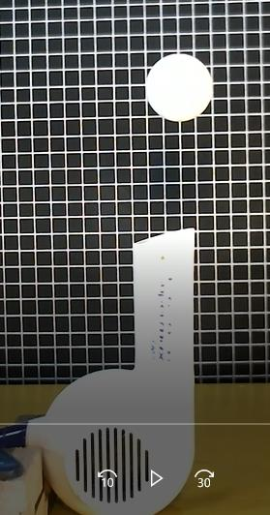
The air flow causes high pressure under the ball. Flow separation on top of the ball causes low pressure.
The vertical pressure imbalance causes the ball to rise.
Low Pressure
High Pressure
High Pressure
Low Pressure
Low Pressure
High Pressure
When the ball moves towards the edge of the flow low pressure is created that sucks the ball back in.

Slide 81
Student Question:
What causes the ball to achieve a certain height and then stabilize?

Slide 82
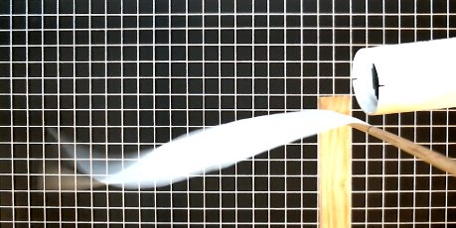
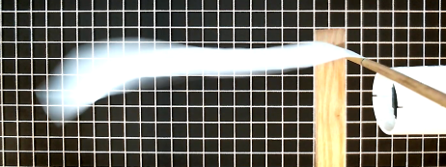
Is this Bernoulli’s Principle at work?
If so, why does the paper go up when the flow is below the paper? Shouldn’t the paper get sucked down?
Flow Above Paper
As depicted below, the streamlines would tend to spread out and thus no low pressure would be generated due to the continuity equation…
Flow Below Paper
Paper

Slide 83
Questions ?

